Slide 1

Interfacing LED, Switch with ARM7 LPC2148
DAY 12
EMBEDDED SYSTEM DESIGN & IoT-Master Class

Slide 2
What You will learn Today?
LPC214X Series Overview
LPC2148 Block Diagram
Embedded system design using ARM7
KEIL For ARM 7
Pins available for GPIO
PIN Connect Block
LED and Switch

Slide 3
Mindset Lesson for the Day
In Every Set-Back There Lies A Gift, A Lesson To Learn & Evolve

Slide 4
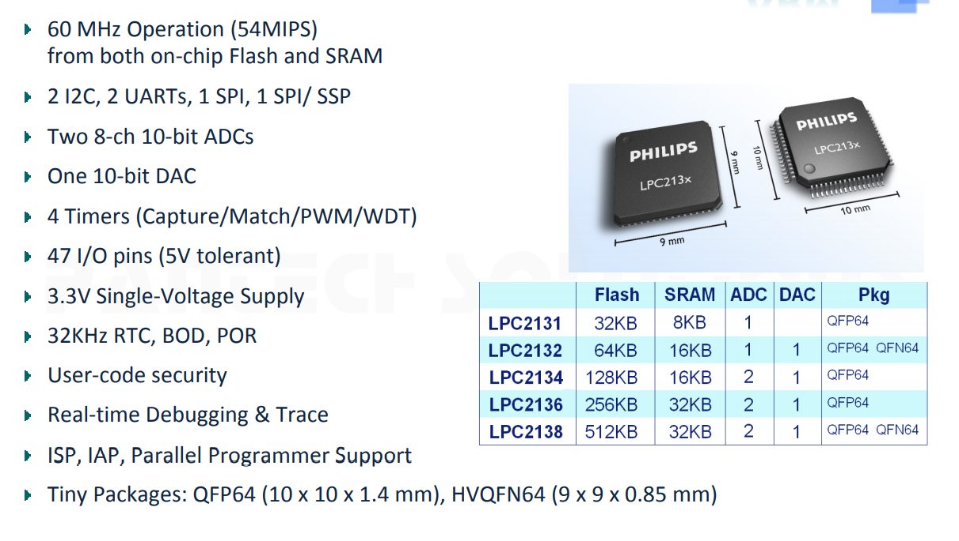
LPC214X Series Overview

Slide 5
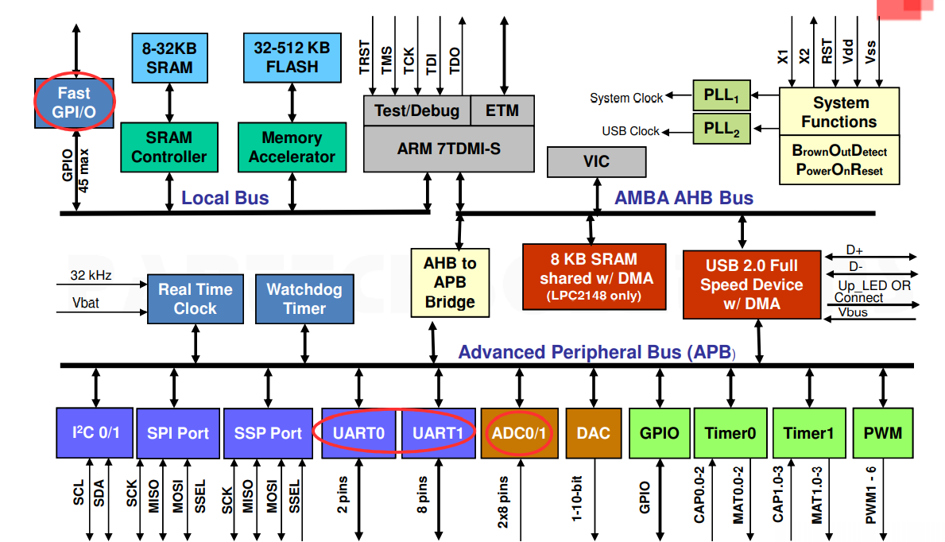
LPC2148 Block Diagram

Slide 6
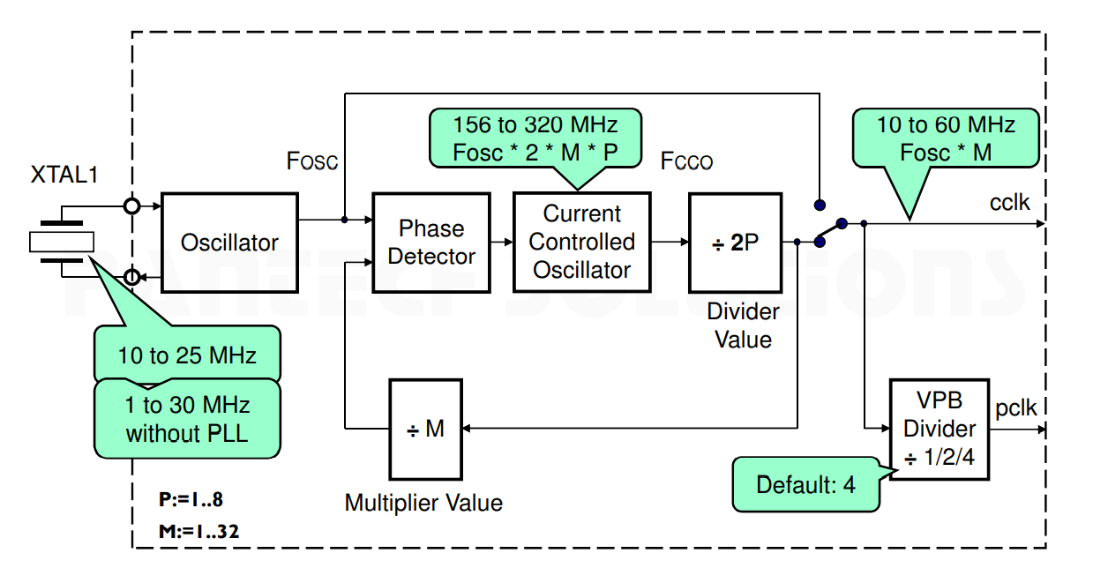
PLL

Slide 7
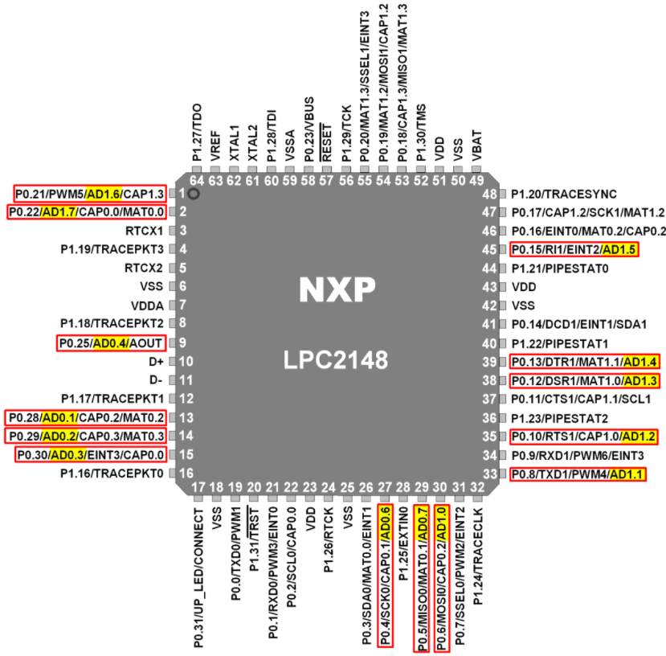
PIN DETAILS

Slide 8
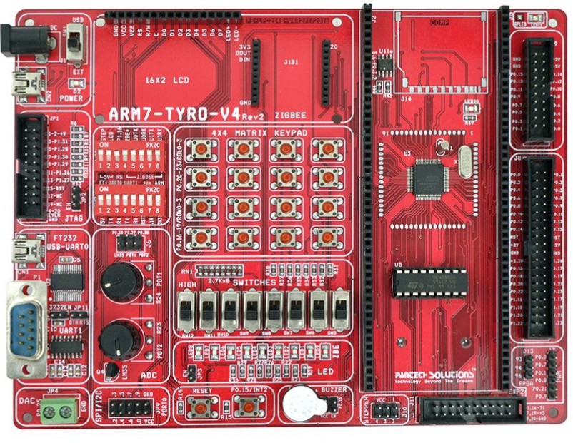
ARM7 Development Board

Slide 9
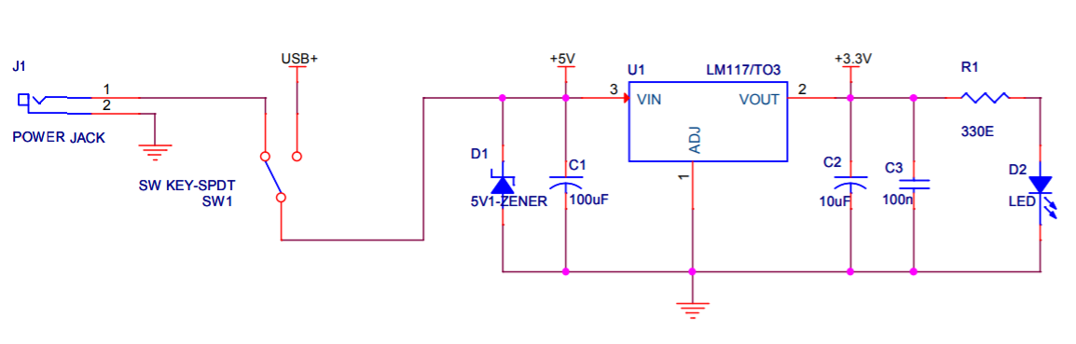
POWER SUPPLY

Slide 10
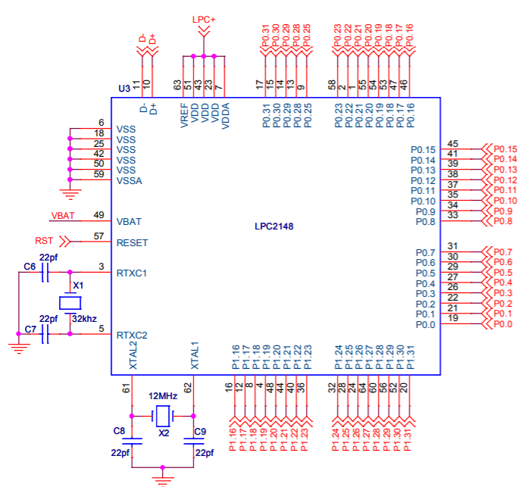
PROCESSOR

Slide 11
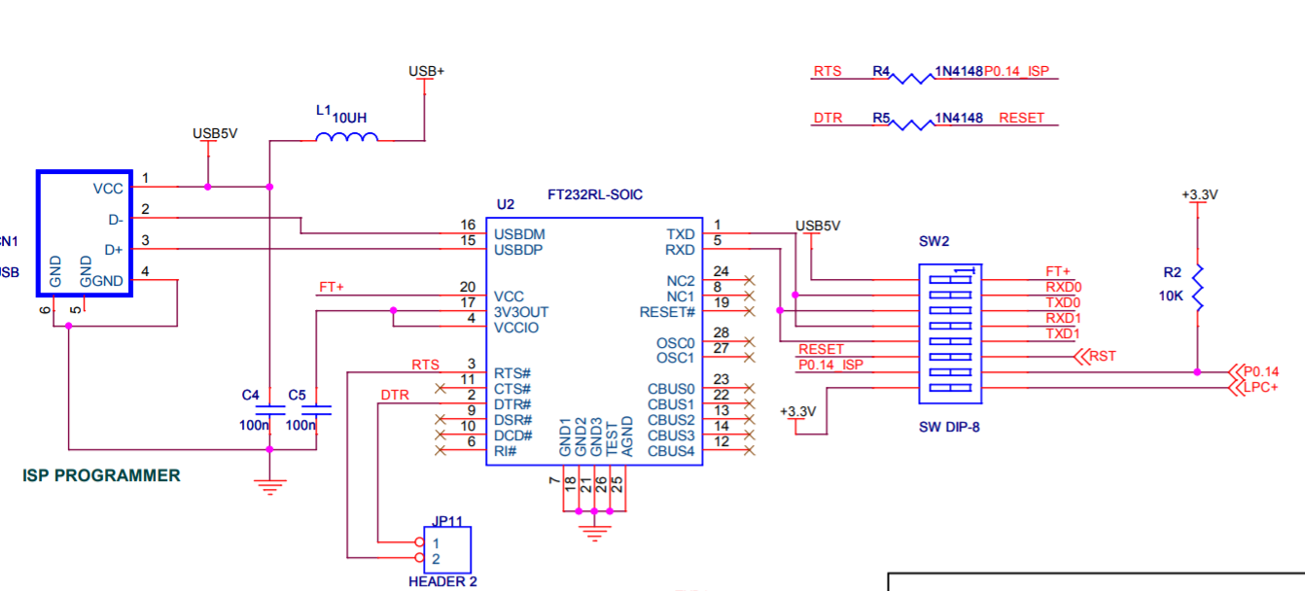
FT232

Slide 12
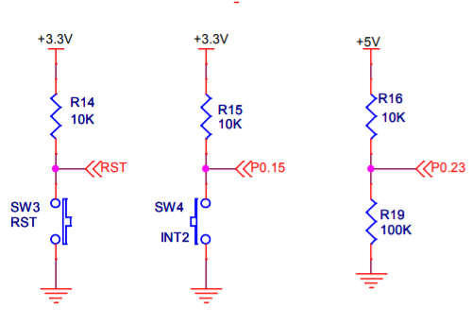
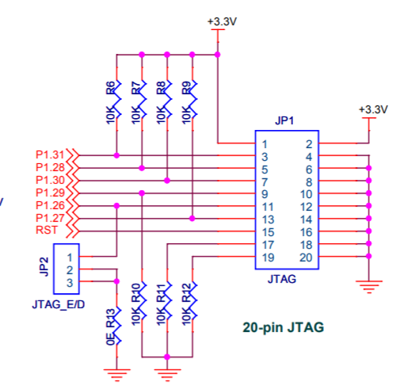
RESET ,JTAG & INTERRUPT

Slide 13
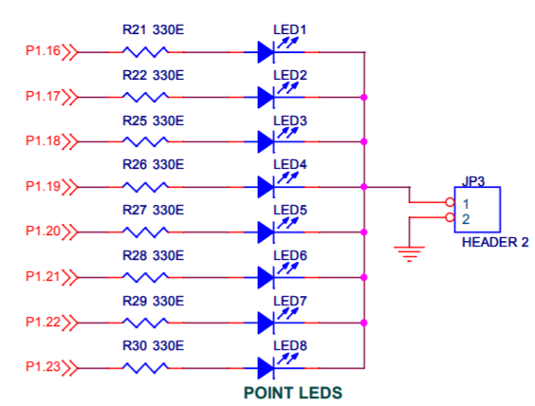
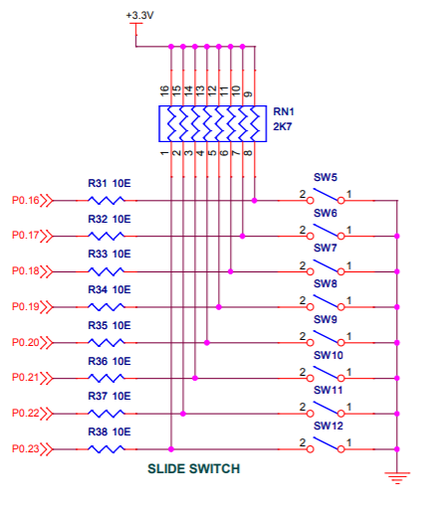
LED & SWITCH

Slide 14
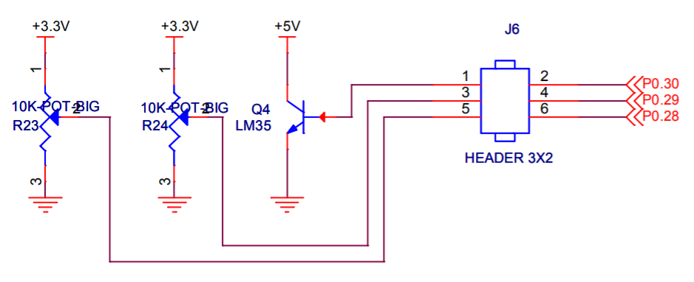
LM35 & POT

Slide 15
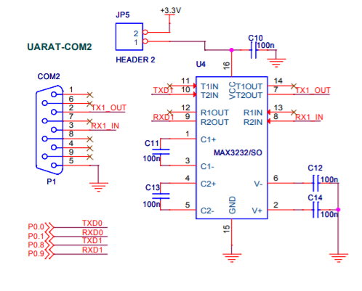
UART

Slide 16
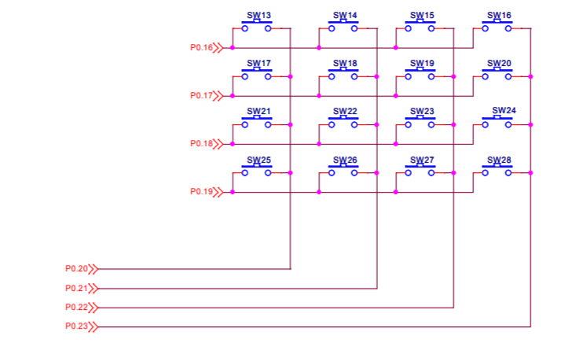
KEYPAD

Slide 17
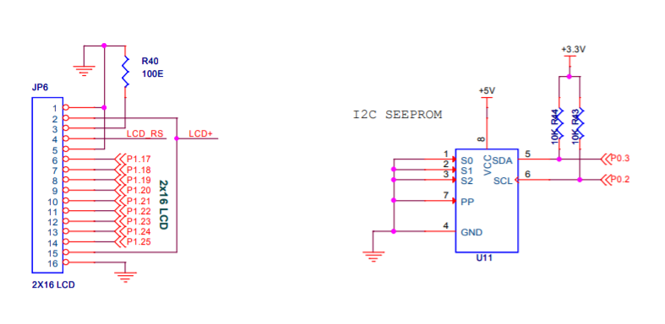
LCD & I2C EEPROM

Slide 18
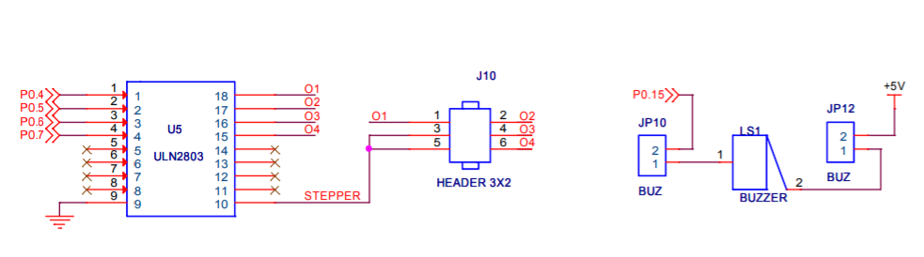
BUZZER & STEPPER

Slide 19
Product support
https://www2.keil.com/mdk5/install
http://www2.keil.com/mdk5/legacy

Slide 20
LED and Switch

Slide 21
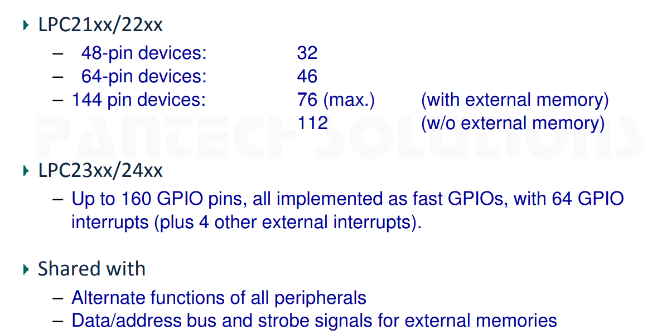
Pins available for GPIO

Slide 22
PIN Select Registers
Pin Function Select Registers are 32-bit registers. These registers are used to select or configure specific pin functionality.
There are 3 Pin Function Select Registers in LPC2148:
1. PINSEL0 : - PINSEL0 is used to configure PORT0 pins P0.0 to P0.15.
2. PINSEL1 : - PINSEL1 is used to configure PORT0 pins P0.16 to P0.31.
3. PINSEL2 : - PINSEL2 is used to configure PORT1 pins P1.16 to P1.31.

Slide 23
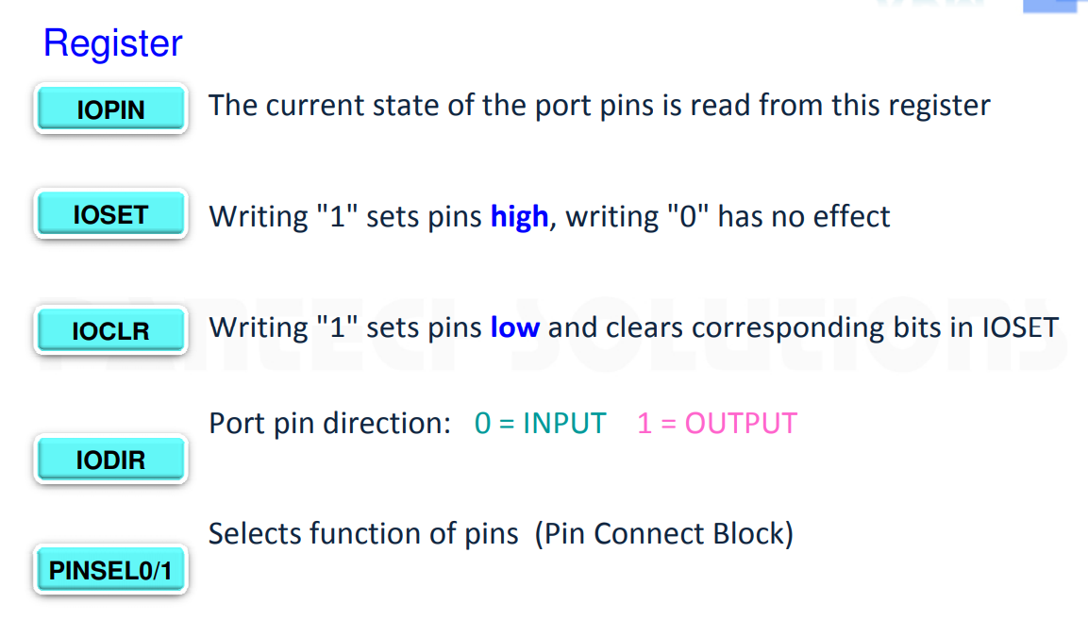
Pin Connect Block (1)

Slide 24
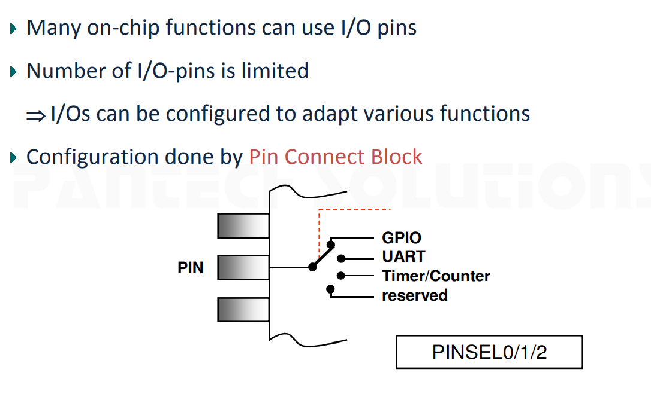
Pin Connect Block (2)

Slide 25
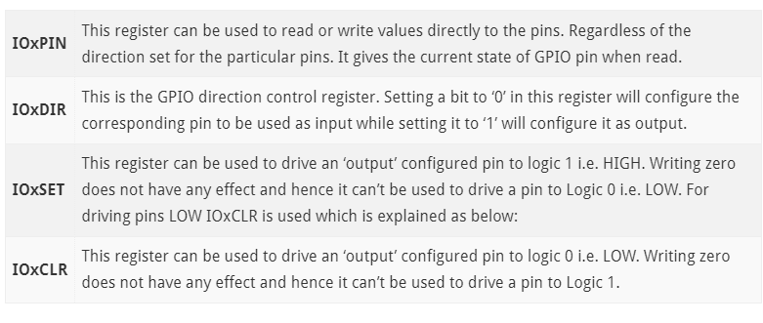
GPIO Related Registers In LPC2148

Slide 26
LPC2148 has two 32-bit General Purpose I/O ports.
1. PORT0
2. PORT1
PORT0 is a 32-bit port
Out of these 32 pins, 28 pins can be configured as either general purpose input or output.
1 of these 32 pins (P0.31) can be configured as general-purpose output only.
3 of these 32 pins (P0.24, P0.26 and P0.27) are reserved. Hence, they are not available for use. Also, these pins are not mentioned in pin diagram.
PORT1 is also a 32-bit port. Only 16 of these 32 pins (P1.16 – P1.31) are available for use as general-purpose input or output.

Slide 27
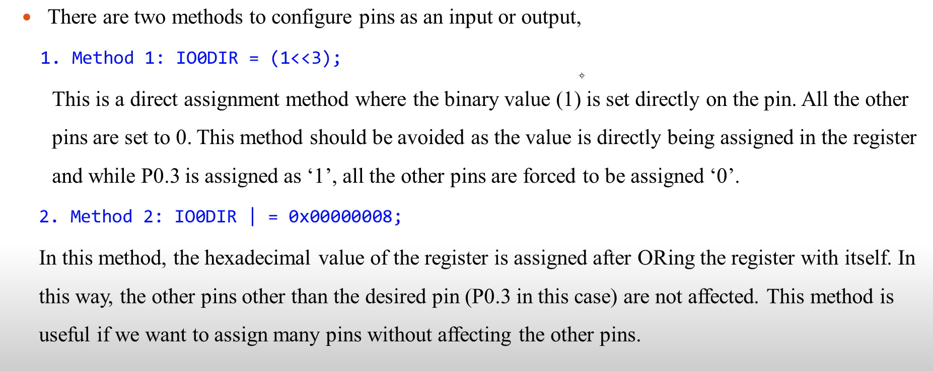
Configuring Pins as Input or Output

Slide 28
LED BLINKING
#include <lpc214x.h>
#include <stdio.h>
#define LED_ROW 0xFF0000 // LED as P1.16 to P1.23
void Delay(unsigned int n);
int main(void)
{
IODIR1 = LED_ROW; //Configure P1.16 to P1.23 as Output
while(1) //loop forever
{
IOSET1 = LED_ROW;
Delay(20);
IOCLR1 = LED_ROW;
Delay(20);
}
}
void Delay(unsigned int n)
{
int i,j;
for(i=0;i<n;i++)
{
for(j=0;j<120000;j++)
{;}
}
}

Slide 29
Switch & LED
#include<lpc214x.h>
#define LED0 0x010000
#define LED1 0x020000
#define LED2 0x040000
#define LED3 0x080000
#define LED4 0x100000
#define LED5 0x200000
#define LED6 0x400000
#define LED7 0x800000
unsigned int SW_RD;
int main()
{
IODIR1 = 0xFF0000; // GPIO pins 16 to 23 configured as output
IODIR0 = 0x000000; //All the GPIO pins configured as input
while(1)
{
SW_RD = ((IOPIN0 & 0xFF0000)>>16 & 0xFF);
if(SW_RD&0x80) IOSET1 = LED0; else IOCLR1 = LED0;
if(SW_RD&0x40) IOSET1 = LED1; else IOCLR1 = LED1;
if(SW_RD&0x20) IOSET1 = LED2; else IOCLR1 = LED2;
if(SW_RD&0x10) IOSET1 = LED3; else IOCLR1 = LED3;
if(SW_RD&0x08) IOSET1 = LED4; else IOCLR1 = LED4;
if(SW_RD&0x04) IOSET1 = LED5; else IOCLR1 = LED5;
if(SW_RD&0x02) IOSET1 = LED6; else IOCLR1 = LED6;
if(SW_RD&0x01) IOSET1 = LED7; else IOCLR1 = LED7;
}
}

Slide 30
Thank You

